Slide 1
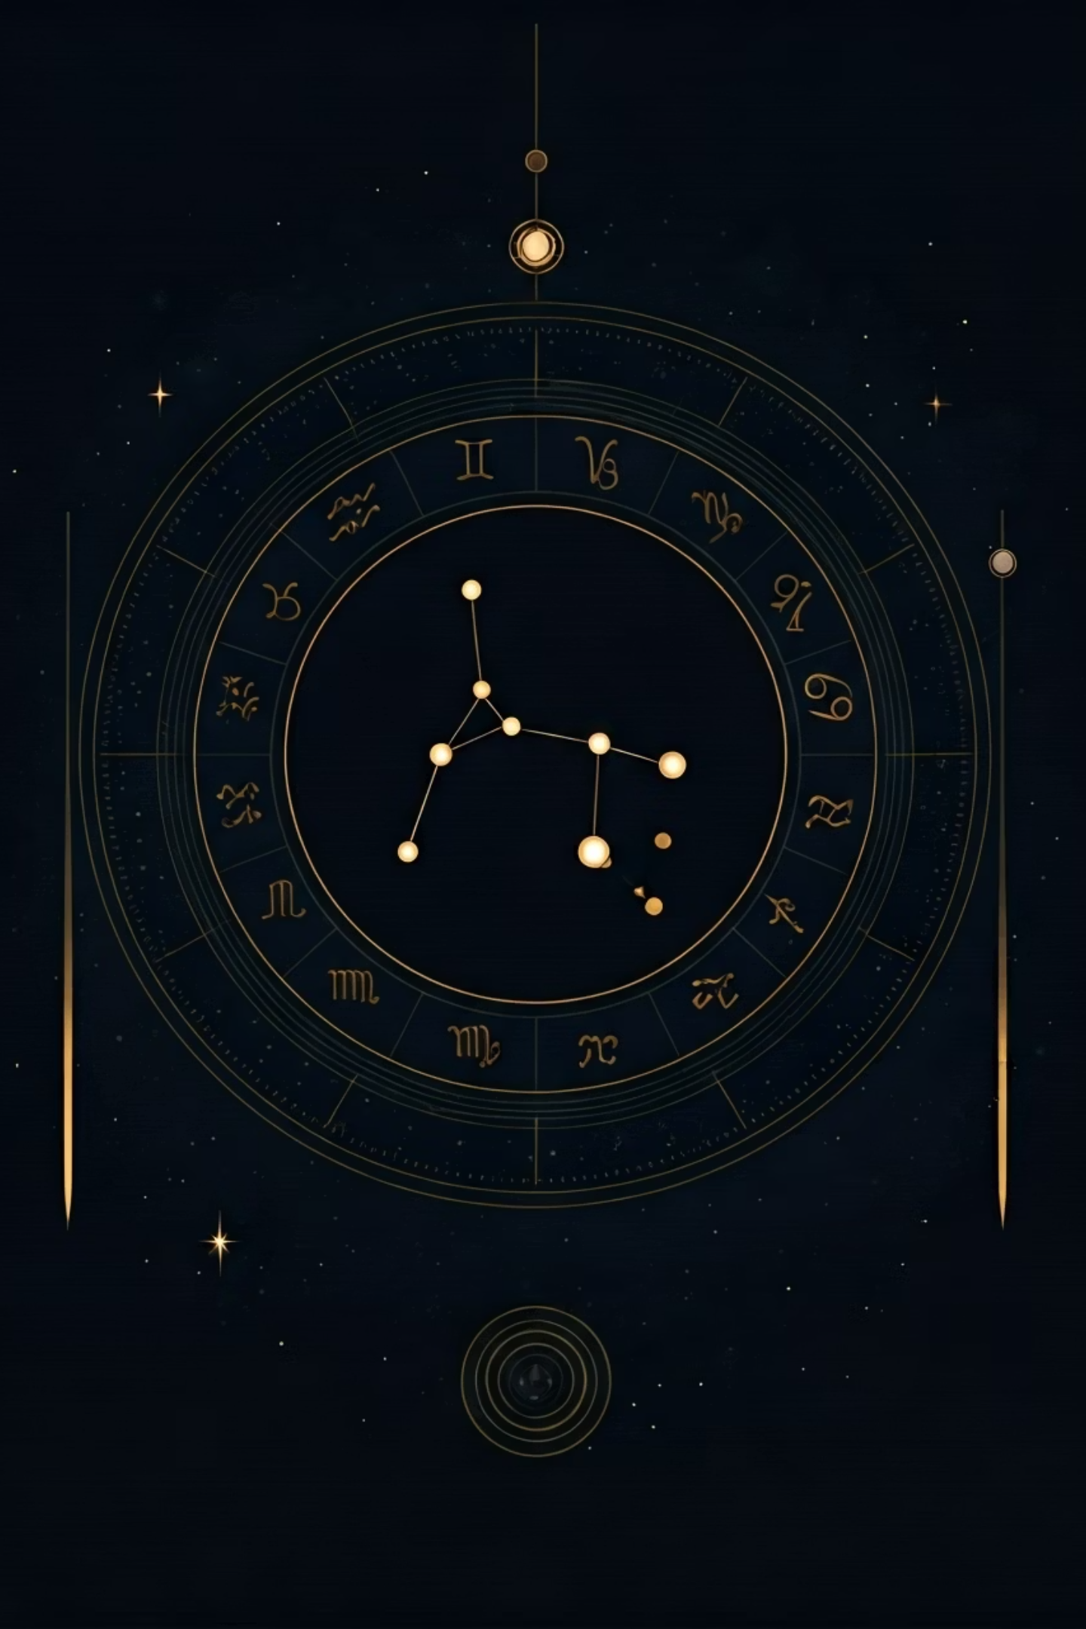
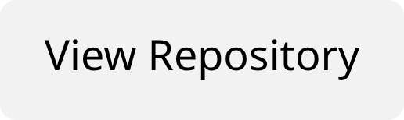

🧬 Date-A-Scientist: Predicting Zodiac Signs from OKCupid Profiles
Francisco Teixeira Barbosa Data Science Portfolio Project
Research Question: Can we predict zodiac signs from dating profile data?
Dataset Overview
48,890 OKCupid profiles across 12 zodiac signs
Tech Stack
Python, Jupyter, Scikit-learn, Pandas, TF-IDF

Slide 2
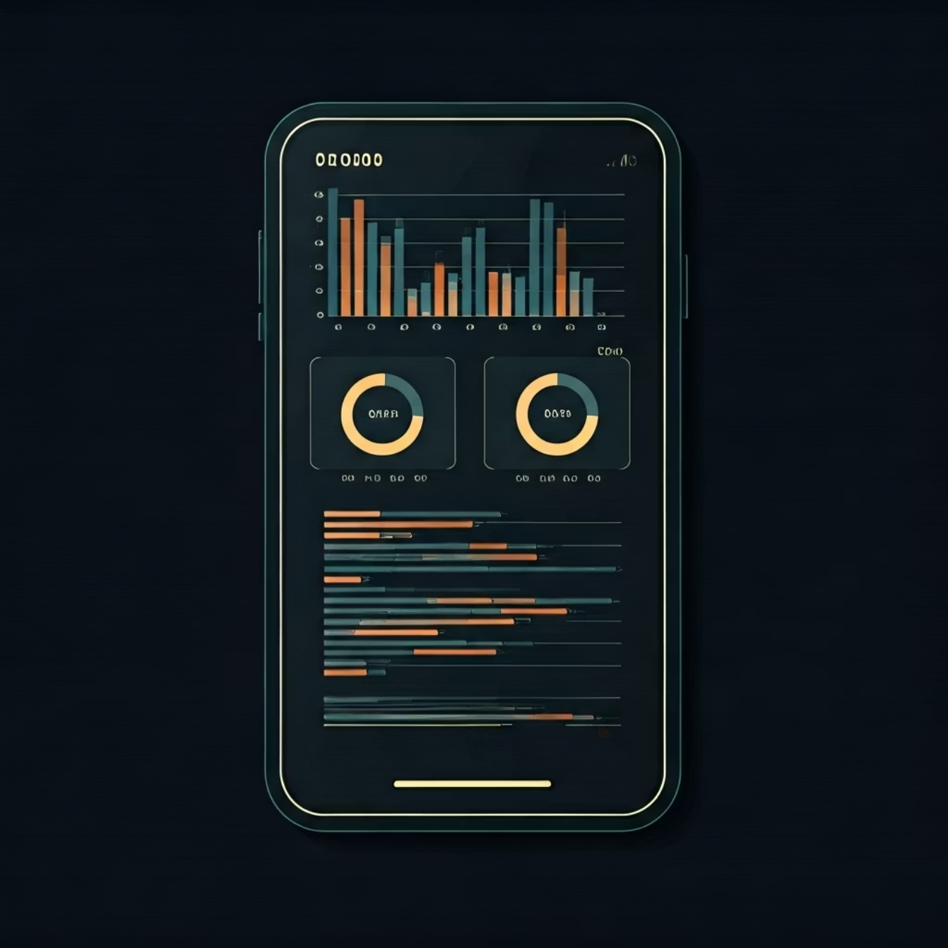
📊 Problem & Data Overview
🎯 Research Question
Can we predict zodiac signs from OKCupid profile data?
📈 Dataset Characteristics
Total Profiles: 48,890 users
Target Classes: 12 zodiac signs
Features: 10 essay fields + 14 attributes
Challenge: Multi-class classification with weak signal
80.8%
96.5%
2,288
Missing Income Data
Profiles with Essays
Average Characters
Significant data quality challenges
Rich textual content available
Per profile essay length

Slide 3
🔬 Methods & Model Performance
01
02
Structured Logistic Regression
Random Forest
Demographics + lifestyle features baseline
Ensemble method for structured features
03
04
Text-only Model
Combined Model
TF-IDF vectorization of essay content
Text + structured features integration
Model
Accuracy
vs Baseline
Baseline (Majority)
8.9%
—
Structured Logistic
8.3%
-0.6%
Random Forest
9.0%
+0.1%
Text-only
9.1%
+0.2%
Key Finding: Text features outperform demographic features — essays contain more predictive signal than lifestyle choices

Slide 4
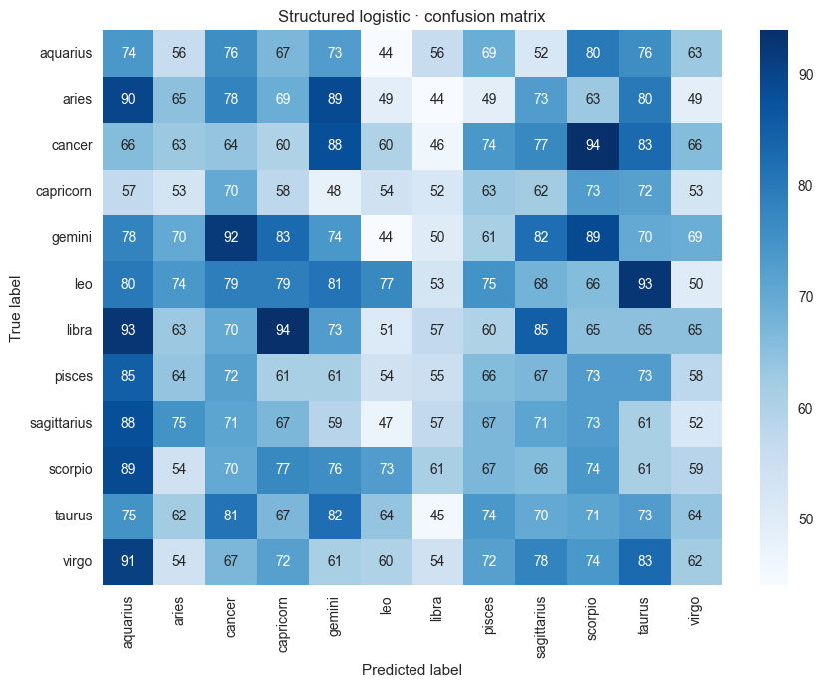
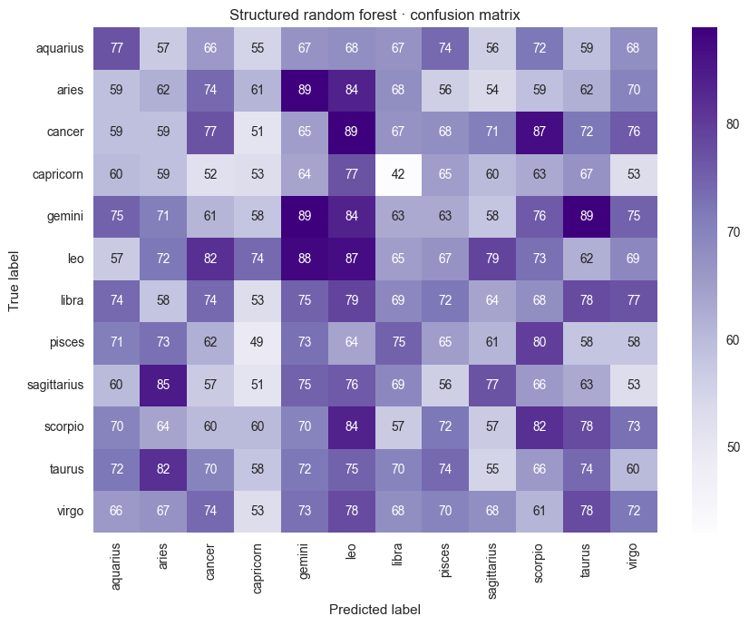
🔍 Insights & Model Analysis
📈 Confusion Matrix Analysis
Model performance reveals random-like predictions across all zodiac signs, confirming weak predictive signals.
🎯 Core Insight
📝 Text Superiority
🔤 Word Patterns
Zodiac signs are not predictable from profile data with current methods
Essays contain more signal than demographic information
Each sign shows distinct vocabulary preferences in essays
📝 Top Discriminative Words by Sign
Cancer: "odd, damn, data, cancer, answering"
Leo: "competitive, saying, foundation, svu, culture"
Pisces: "evenings, annoying, policy, different types, camping"

Slide 5



🎯 Conclusions & Future Work
Main Findings
Scientific Implications
Best model: 9.1% accuracy vs 8.9% baseline
Personality traits are complex
Text outperforms demographics
Zodiac signs lack measurable differences
Data quality significantly impacts results
Subtle text patterns insufficient for prediction
🚀 Future Directions
📚 Key Learning Outcomes
Advanced NLP feature engineering
End-to-end ML pipeline implementation
Deep learning text classification
TF-IDF vectorization mastery
Data augmentation techniques
Model evaluation and interpretation
Alternative prediction targets
Data quality assessment skills

